Slide 1

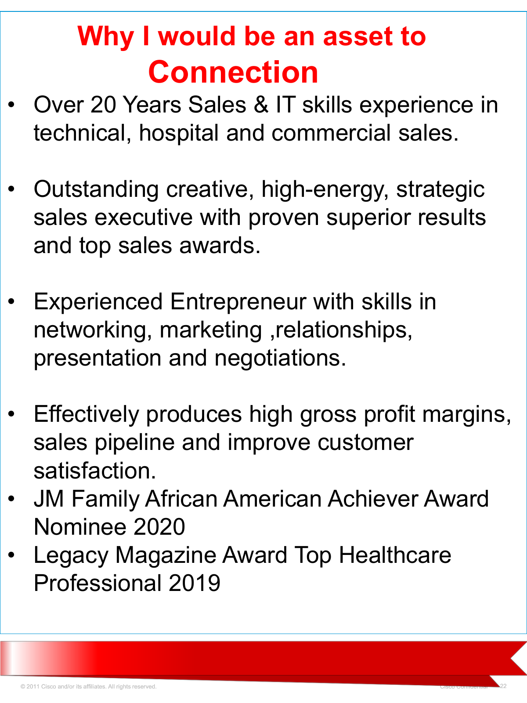
CLEAN EVIDENCE DECK
Grant McGaugh
$200M+ Career Sales Record
Connection-aligned source deck cleaned for website proof review.
No CDW employment claim included.
Source artifact: 03/30/2020 Healthcare Enterprise Sales Executive deck
Original title slide
Connection-oriented slide
Prepared for 5 STAR BDM | Source-proof review | Not for public publication without source review
Notes:
[Sources]
Original source deck: /mnt/data/Grant McGaugh AWS - Healthcare Enterprise Sales Executive.pdf. Page 1 title slide and page 22 Connection-specific slide.

Slide 2
EVIDENCE POSITION
What this deck proves - and what it does not
$200M+
$13.1M
Connection
reported cumulative career sales by 03/30/2020
named enterprise wins documented in source deck
presentation target; not CDW employment
Approved interpretation
Do not publish
Use as proof of Grant McGaugh's cumulative career sales experience across enterprise technology, healthcare, telecommunications, cloud, networking, unified communications and business development.
Do not describe this as "$200M in 5 STAR BDM client success" or imply that Grant was hired by CDW. The CDW language is a residual slide reference and should be excluded from the clean evidence record.
Recommended website language: "$200M+ in cumulative career sales reported through March 2020 across enterprise technology, healthcare and business development."
Internal evidence deck | 5 STAR BDM | Not for public publication without source review
Notes:
[Sources]
Primary source: /mnt/data/Grant McGaugh AWS - Healthcare Enterprise Sales Executive.pdf. Page 5 states Grant brought in collectively over $200 million in sales over his career. Page 6 lists named enterprise wins totaling $13.1M. Page 22 references Connection.

Slide 3
SOURCE CHAIN
Source artifact: Connection-oriented presentation
Cover confirms deck title and date: 03/30/2020
Page 22 identifies the opportunity as Connection
Clean conclusion: use this as a Connection-aligned source artifact. Any CDW wording elsewhere in the source is not part of the clean claim and should not be repeated.
Internal evidence deck | 5 STAR BDM | Not for public publication without source review
Notes:
[Sources]
Original source deck: /mnt/data/Grant McGaugh AWS - Healthcare Enterprise Sales Executive.pdf. Page 1 and page 22.

Slide 4
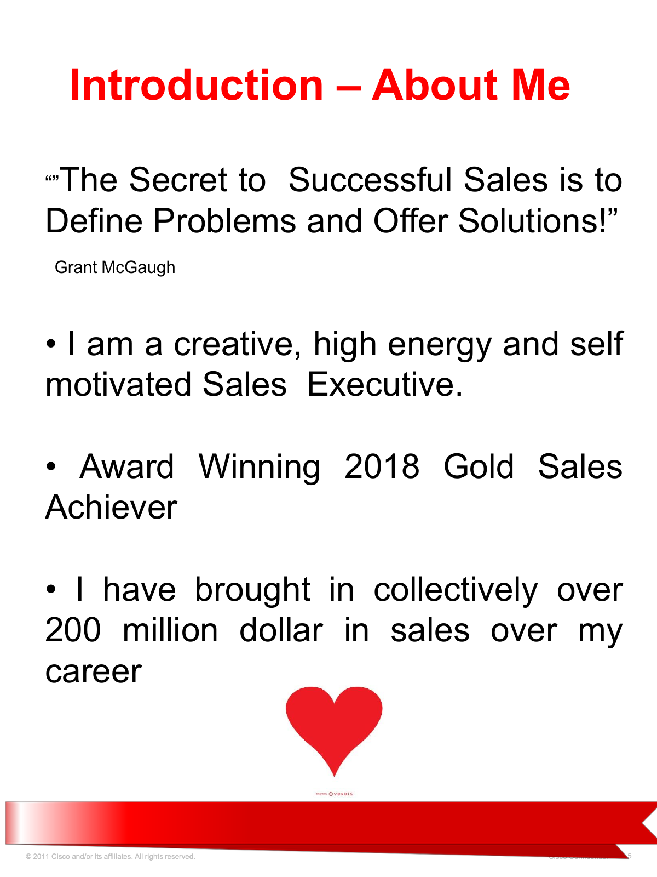
PRIMARY EVIDENCE
$200M+ statement appears in the original deck
Source wording
“I have brought in collectively over 200 million dollar in sales over my career.”
Recommended cleaned attribution
$200M+ cumulative career sales reported by Grant McGaugh as of March 30, 2020.
Use for career proof. Do not use as a guarantee, client-result average, or 5 STAR BDM-only revenue claim.
Page 5 - “Introduction - About Me”
Internal evidence deck | 5 STAR BDM | Not for public publication without source review
Notes:
[Sources]
Original source deck: /mnt/data/Grant McGaugh AWS - Healthcare Enterprise Sales Executive.pdf. Page 5 contains the $200M+ cumulative career sales statement.

Slide 5
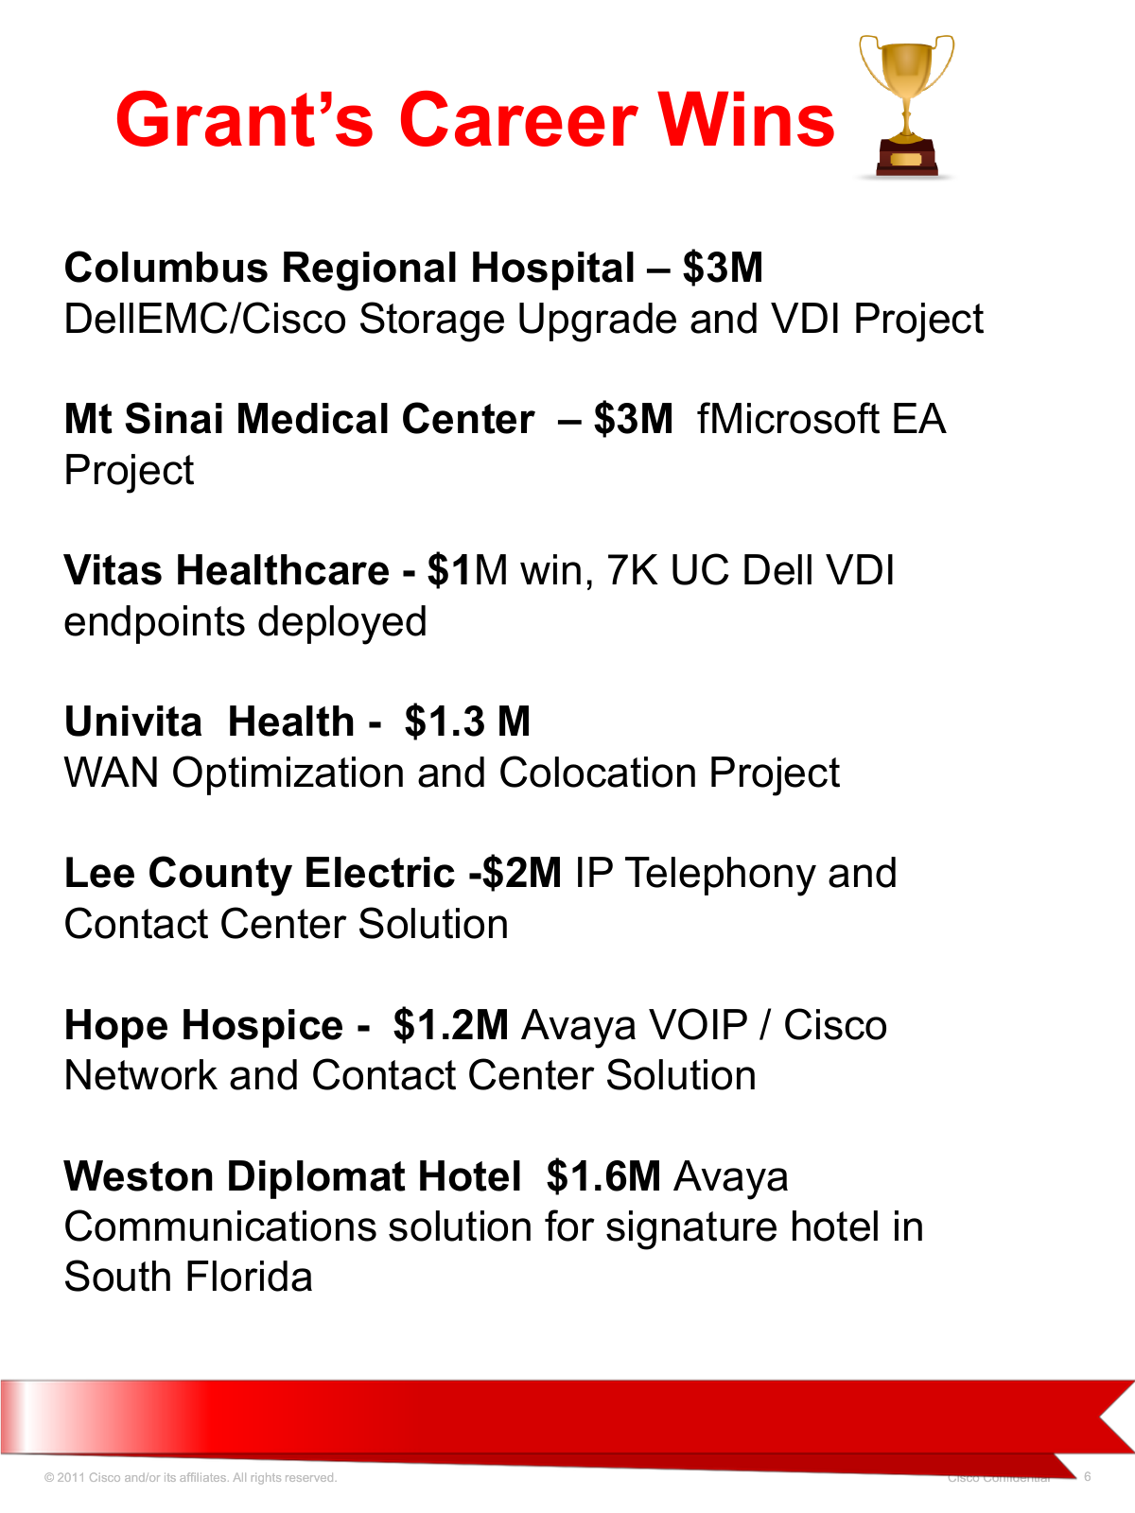
SUPPORTING EXAMPLES
Named enterprise wins documented in the source deck
Account
Value
Work included
Columbus Regional Hospital
$3.0M
Storage upgrade + VDI
Mt. Sinai Medical Center
$3.0M
Microsoft EA project
VITAS Healthcare
$1.0M
7K UC + Dell VDI endpoints
Univita Health
$1.3M
WAN optimization + colocation
Lee County Electric
$2.0M
IP telephony + contact center
Hope Hospice
$1.2M
Avaya VOIP / Cisco network
Weston Diplomat Hotel
$1.6M
Avaya communications
Named examples total
$13.1M
Documented subset of larger $200M+ career figure
The named examples total $13.1M and support the credibility of the larger cumulative career-sales statement.
Page 6 - documented “Career Wins”
Internal evidence deck | 5 STAR BDM | Not for public publication without source review
Notes:
[Sources]
Original source deck: /mnt/data/Grant McGaugh AWS - Healthcare Enterprise Sales Executive.pdf. Page 6 lists the named enterprise wins: Columbus Regional Hospital $3M, Mt Sinai Medical Center $3M, VITAS Healthcare $1M, Univita Health $1.3M, Lee County Electric $2M, Hope Hospice $1.2M, Weston Diplomat Hotel $1.6M.

Slide 6
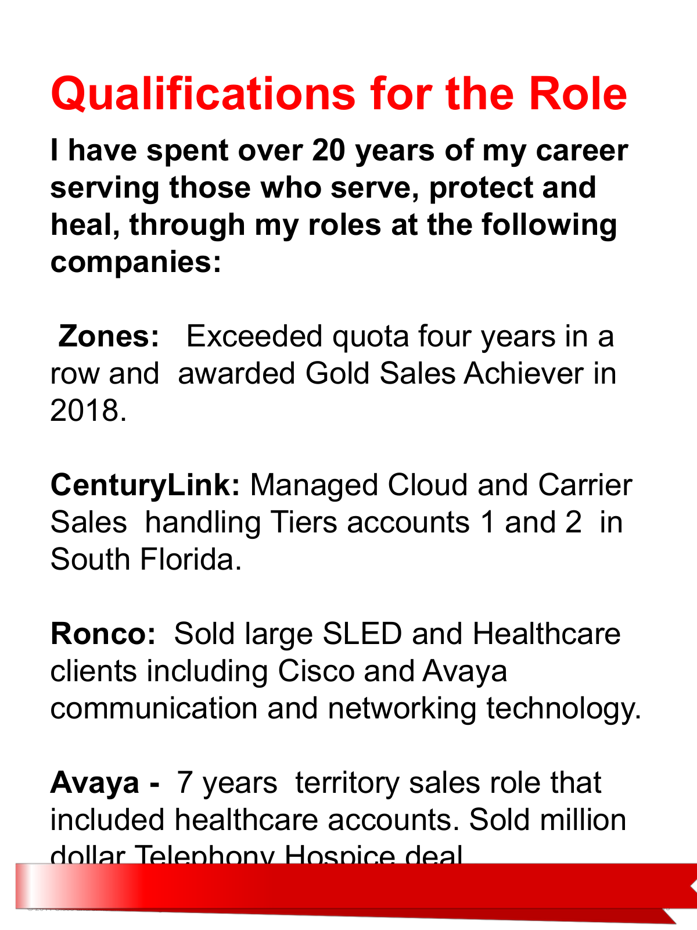
EMPLOYMENT CLARITY
Career foundation: roles named in the source
Zones
Exceeded quota four years in a row; 2018 Gold Sales Achiever
CenturyLink
Managed cloud and carrier sales for Tier 1 and Tier 2 accounts in South Florida
Ronco
Sold large SLED and healthcare clients using Cisco and Avaya technology
Avaya
Seven years in territory sales with healthcare accounts
Clean language to Fahad
Do not state that Grant was hired by CDW. The clean employment/career source language should reference the roles named above and the Connection-oriented presentation context.
Page 13 - roles named in the source deck
Internal evidence deck | 5 STAR BDM | Not for public publication without source review
Notes:
[Sources]
Original source deck: /mnt/data/Grant McGaugh AWS - Healthcare Enterprise Sales Executive.pdf. Page 13 lists Zones, CenturyLink, Ronco and Avaya roles. CDW should not be presented as employment history.

Slide 7
PUBLISHING COPY
Website proof language: clean version
Primary claim
$200M+ in cumulative career sales reported through March 2020 across enterprise technology, healthcare, telecommunications and business development.
Attribution line
Source: Grant McGaugh, Healthcare Enterprise Sales Executive presentation, March 30, 2020. Prepared for a Connection opportunity; internal evidence copy.
Claims to remove or avoid
- $100M+ in Client Success unless separately sourced to actual client outcomes
- 5K+ reviews, 4.8/4.9/5.0 ratings unless tied to a verified public review platform
- Any implication Grant was hired by CDW; use the Connection context instead
Internal evidence deck | 5 STAR BDM | Not for public publication without source review
Notes:
[Sources]
Source: /mnt/data/Grant McGaugh AWS - Healthcare Enterprise Sales Executive.pdf. Primary sales claim on page 5; Connection context on page 22. Review-count and star-rating claims are not included because no verified independent review source was found.

Slide 8
ACTION CHECKLIST
Implementation instructions for Fahad
Use
Career-sales language with source, date, period and attribution.
Attach
This clean deck or original source deck only for internal proof review.
Remove
Unsupported 5K+ review-count and star-rating claims until verified.
Avoid
Any CDW employment implication. The source is Connection-oriented.
Preserve
BRAVE, 5 STAR BDM positioning, Omaha contact details and active booking journey.
Bottom line
The clean, defensible proof is stronger than the old claim: $200M+ cumulative career sales, attributed correctly, with named enterprise examples and no unsupported review metrics.
Prepared for Fahad Mukhtar website corrections | Not for public publication without source review
Notes:
[Sources]
Source: /mnt/data/Grant McGaugh AWS - Healthcare Enterprise Sales Executive.pdf. Clean usage instructions derived from source review and claims audit.

